Slide 1

Anticoagulation in APLS Stroke: PRO
Danielle Nascondiglio, DO
Dept of Neurology

Slide 2
Background
Approximately 30% of ischemic strokes fit into “undetermined” etiology
For these patients, especially those without traditional vascular risk factors, it is crucial to investigate for the rarer causes of stroke

Slide 3
Background
APLS-related stroke is a manifestation of a prothrombotic autoimmune state; the mechanism is arterial thrombosis
3 antibodies (lupus anticoagulant, anti-cardiolipin, beta2-glycoprotein)

Slide 4
Why check for APLS?
aPL antibodies are found in a meaningful minority of ischemic stroke patients, especially younger patients
~13% of APS patients present with stroke as the first manifestation of disease.
Identification can change management

Slide 5
Guidelines
For patients meeting APS criteria after stroke, the AHA/ASA states: "the available evidence favors anticoagulation with VKA compared with aspirin to reduce recurrent arterial thromboses.”
EULAR: In patients with definite APS and first arterial thrombosis: Treatment with VKA is recommended over treatment with LDA only.
Notes:
The use of VKA over LDA is supported by data from observational studies that showed a lower likelihood of recurrent thrombosis among patients with APS and prior arterial thrombosis (mainly stroke) treated with VKA versus LDA alone

Slide 6
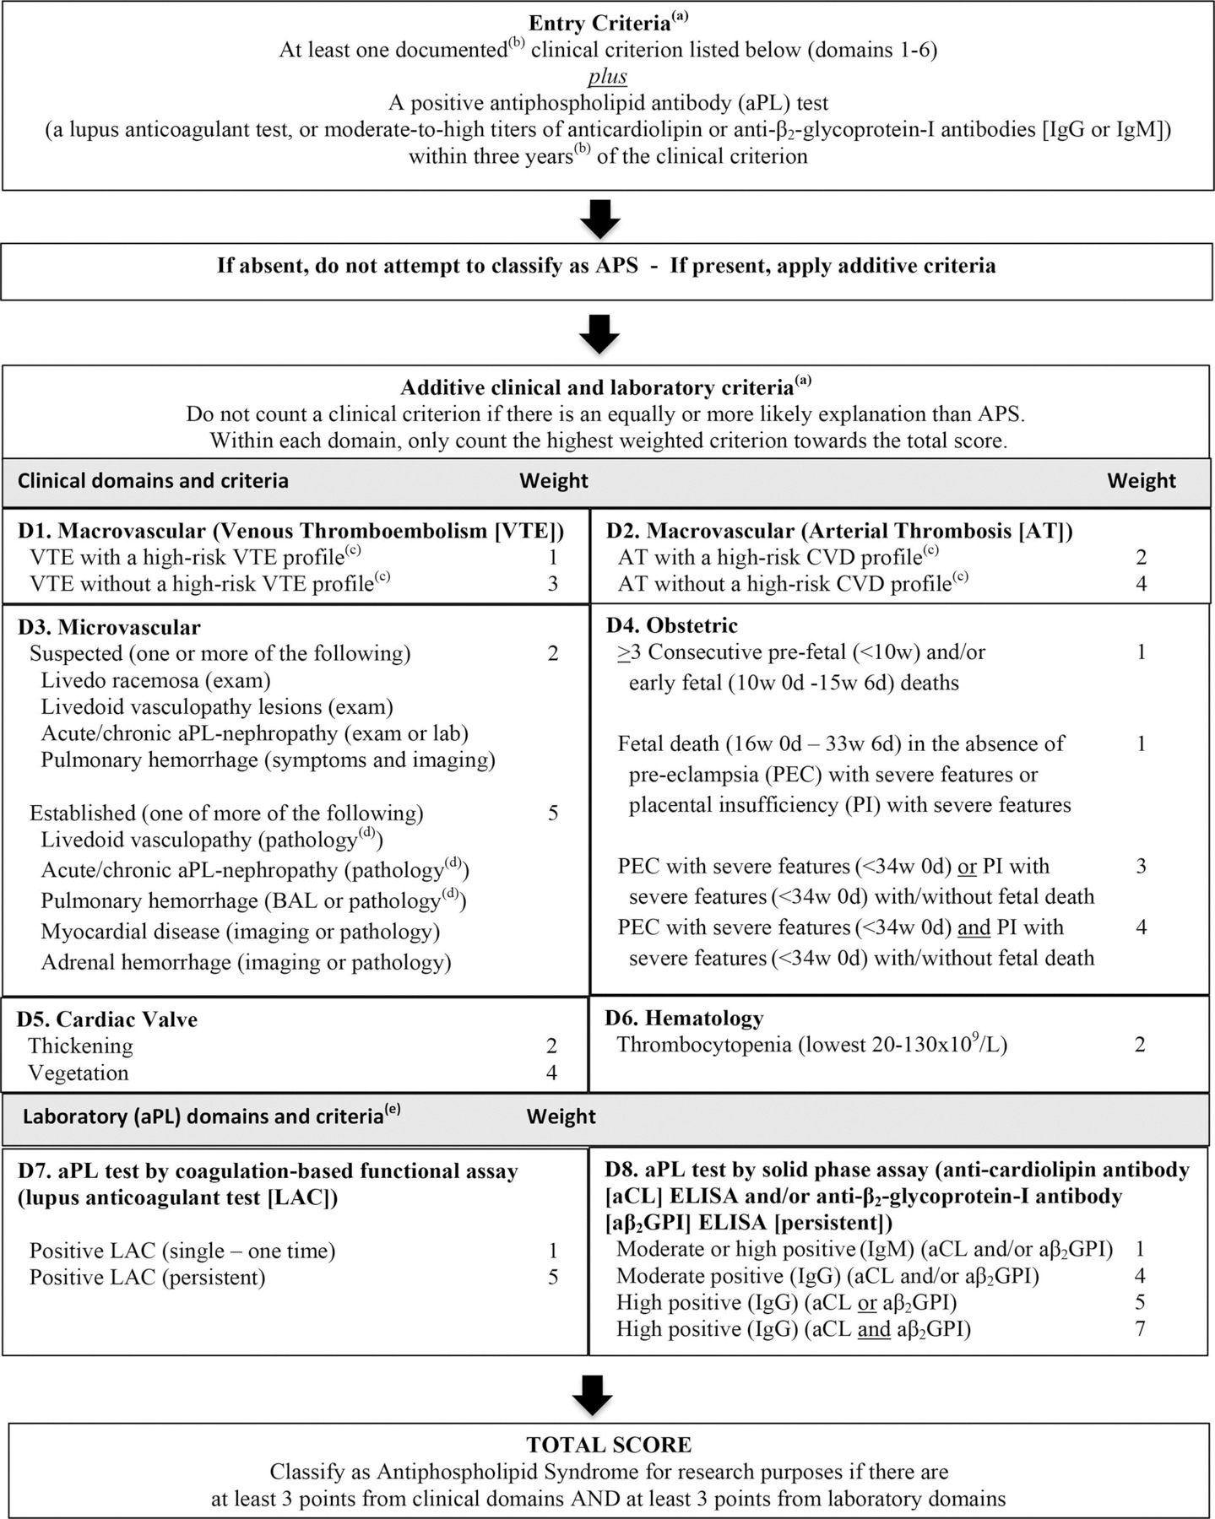
Diagnostic Criteria

Slide 7
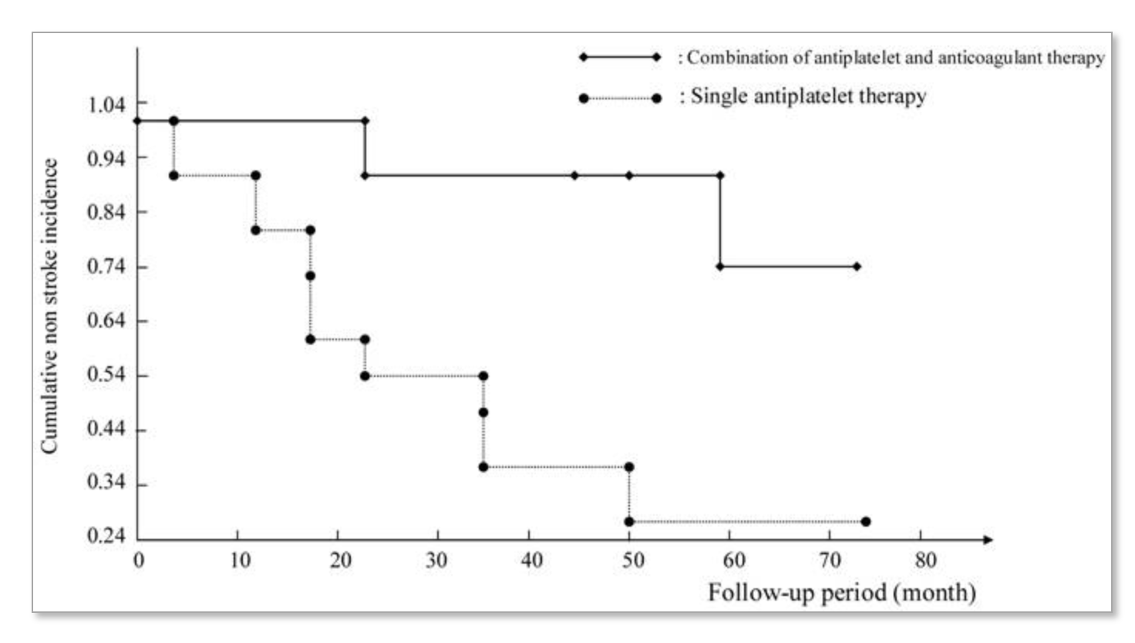
Evidence
Notes:
Small RCT (N=20), Eligible patients were randomly assigned to either single antiplatelet therapy (aspirin 100 mg) or a combination of antiplatelet and anticoagulation therapy (target INR: 2.0-3.0; incidence of hemorrhage similar

Slide 8
Evidence
TRAPS (2021): VKA vs rivaroxaban, terminated early due to increased thrombotic events in DOAC *triple positive patients
ORDI-ROS (2019): VKA vs rivaroxaban, recurrent strokes exclusively in rivaroxaban group *60% triple positive
Notes:
Unlike TRAPS (which enrolled only triple-positive patients), Ordi-Ros included a mixed-risk population and found no statistical interaction indicating a differential treatment effect between patients with 1–2 antibodies versus triple positivity

Slide 9
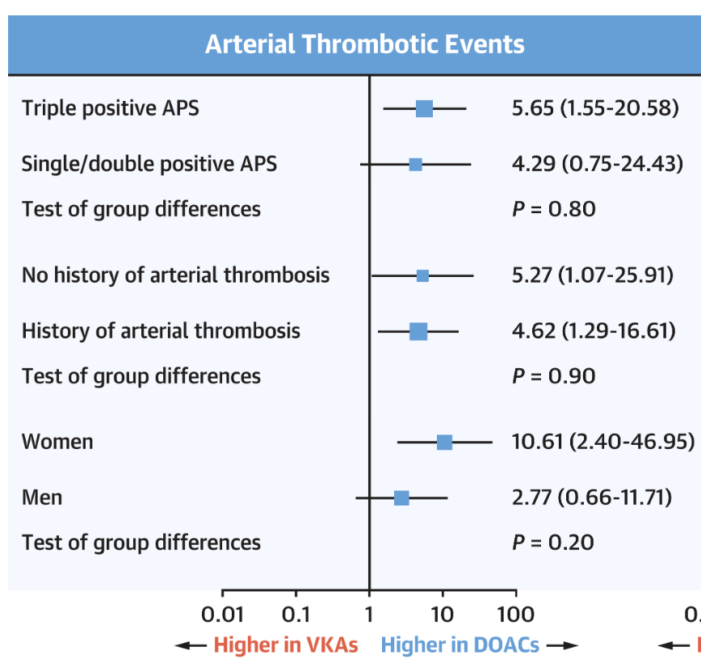
“But it’s just ONE antibody”
Notes:
Meta-analysis of 4 RCTs of DOAC vs VKA in patients with APLS

Slide 10
APASS
Prospective cohort study within WARSS (warfarin vs aspirin)
1770 patients underwent aPL antibody testing; 41% positive, 59% negative
No difference in thrombo-occlusive events
Only underwent one laboratory test
Notes:
here was no increased risk of thrombo-occlusive events associated with baseline aPL status in patients treated with either warfarin (relative risk [RR], 0.99; 95% confidence interval [CI], 0.75-1.31; P = .94), or aspirin (RR, 0.94; 95% CI, 0.70-1.28; P = .71)

Slide 11
Case
88 y/o male with hx of multiple vascular risk factors presented with L facial droop. Confirmed to have embolic appearing R PCA territory stroke.
Workup:
  TEE: no LA thrombus or valvular abnormalities
  CT CAP: R renal mass (present since 2017); D-dimer 620
  APLS labs: cardiolipin IgG 16 (upper limit of normal 14), beta2 glycoprotein IgA > 150, rest of antibodies wnl

Slide 12
Case
Loop recorder placed & discharged on ASA
Approximately 2 months later transferred back to hospital from rehab with R hemiparesis + dysarthria in setting of acute L corona radiata infarct
Loop recorder interrogated; no episodes of Afib
Repeat APLS labs:
  Cardiolipin IgG 40, IgM 19, beta2 glycoprotein IgA > 150; rest wnl

Slide 13
Proposed Approach
In patients with undetermined cause of stroke, send APLS antibody profile
If positive, anti-coagulate
Repeat labs in 12 weeks to determine next steps

Slide 14
Conclusion
aPL associated stroke is mechanistically thrombotic
Both AHA/ASA and EULAR favor anticoagulation in guidelines for secondary stroke prevention, but lacking adequate data for all antibody profiles
The possible high recurrent stroke risk potentially outweighs relatively low bleeding risk on short-term AC

Slide 15
References
Chighizola CB, Ubiali T, Meroni PL. Treatment of Thrombotic Antiphospholipid Syndrome: The Rationale of Current Management—An Insight into Future Approaches. J Immunol Res. 2014;2014:951424.
Crossette-Thambiah C, Rajakaruna I, Odho Z, et al. Anticoagulation, Recurrent Thrombosis, and Major Bleeding in Antiphospholipid Syndrome: UK Multicenter Observational Study. Blood Adv. 2026.
Khairani CD, Bejjani A, Piazza G, et al. Direct Oral Anticoagulants vs Vitamin K Antagonists in Patients With Antiphospholipid Syndromes: Meta-Analysis of Randomized Trials. J Am Coll Cardiol. 2023;81(1):16-30.
Levine SR, Brey RL, Tilley BC, et al; APASS Investigators. Antiphospholipid Antibodies and Subsequent Thrombo-occlusive Events in Patients With Ischemic Stroke. JAMA. 2004;291(5):576-584. doi:10.1001/jama.291.5.576. PMID: 14762036.
Lim W, Crowther MA, Eikelboom JW. Management of Antiphospholipid Antibody Syndrome: A Systematic Review. JAMA. 2006;295(9):1050-1057.
Okuma H, Kitagawa Y, Yasuda T, Tokuoka K, Takagi S. Comparison Between Single Antiplatelet Therapy and Combination of Antiplatelet and Anticoagulation Therapy for Secondary Prevention in Ischemic Stroke Patients With Antiphospholipid Syndrome. Int J Med Sci. 2009;7(1):15-18. doi:10.7150/ijms.7.15. PMID: 20046231.

