Slide 1
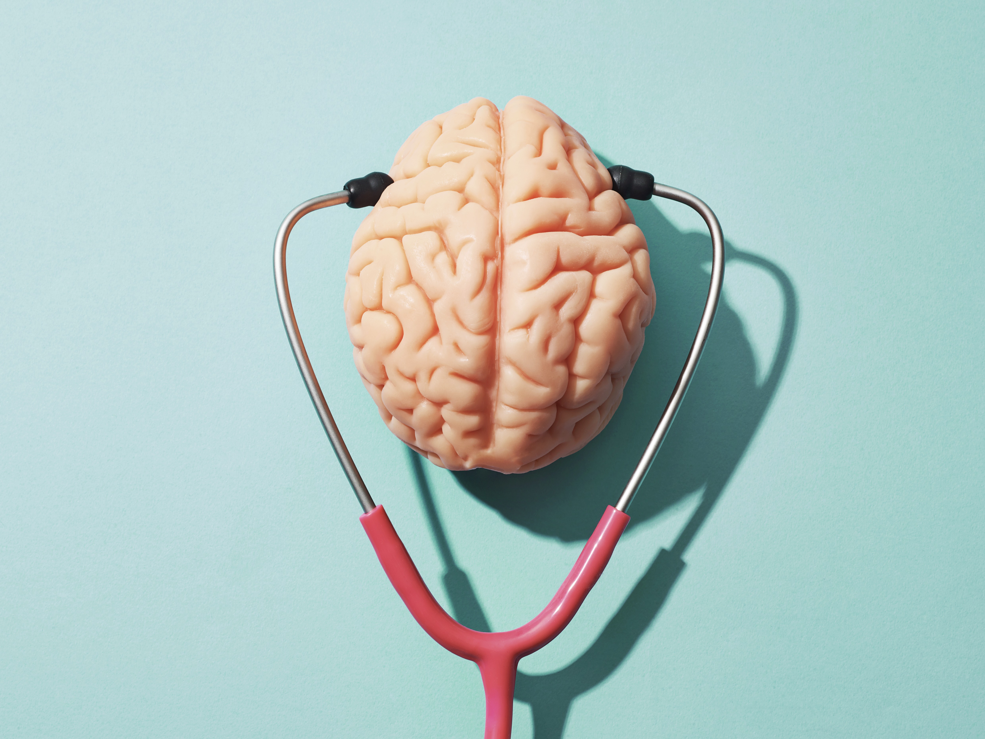
To Score or Not to Score
Javicia Peterson-Cole DNP, RN, APN, NP-C, SCRN

Slide 2
No disclosures

Slide 3
Objectives
Neuro exams
Symptom recognition/localization
NIHSS scoring

Slide 4
Why do we do a neurologic exam?
Notes:
General audience question?
Talking points:
How do we recognize symptoms? by doing an examination.
nursing neurologic exam vs NIHSS (many components of the NIHSS can be obtained from regular Neuro assessment)

Slide 5
Purpose
Why is it important to know exactly where the stroke is in the brain?
Nurses need to know
Notes:
Talking points:
-Purpose: to establish a baseline, normal vs abnormal, change in symptoms; report focal changes immediately, to localize the stroke;
-Why is it important to know where the stroke is?: To assess/predict further risks to the patient; Symptom recognition: Important to have an idea of the brain territories and associated symptoms.
Nurses need basic understanding of brain function, territories: Large vessel vs. small vessel, Anterior circulation vs. posterior circulation, Right side or left side symptoms
5

Slide 6
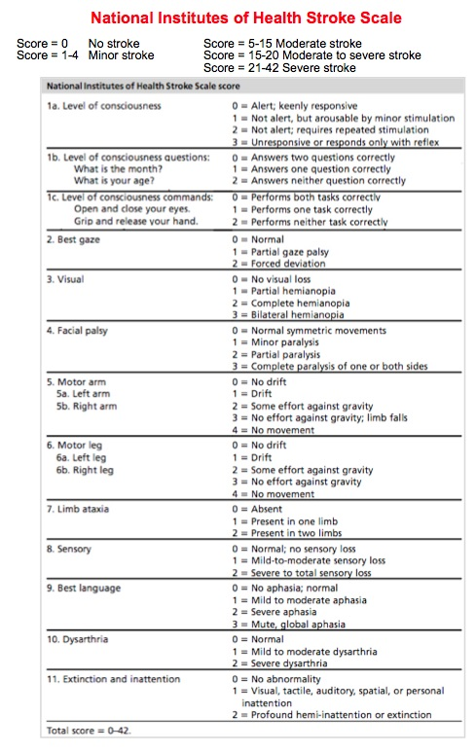
Neurologic Examination VS NIHSS
Neuro Exam (6 components)
NIHSS (11-components)
LOC/Mental status
Pupils & Cranial nerves
Motor function
Sensory
Cerebellar & Coordination
Speech, Language, Communication
Notes:
Examining your patient frequently will allow you to determine changes (improvement vs worsening); what is considered debilitating to a patient?
Neuro exam: 6 main components; NIHSS: Comprising 11 components, the NIHSS provides a structured assessment of consciousness, motor strength, language, sensation, coordination, and neglect. Important factor NIHSS does not completely capture posterior circulation strokes.

Slide 7
Cont’d
Neuro Exam
NIHSS
LOC & MS
Pupils & Cranial Nerves
Motor Function
Sensory Function
Coordination/Cerebellar Function & Gait
Speech, Language & Communication
1a. LOC 1b. LOC questions 1c. LOC commands
2) Best gaze 3) Visual fields 4) Facial palsy
5) Motor arm 6) Motor leg
8)Sensory 11) Extinction/Inattention
Limb ataxia
9) Best language 10) Dysarthria
Notes:
Depicts the comparison of the Neuro Exam (broad, clinical and detects neuro change) and NIHSS 11-point scale (standardized scale, stroke based, quantifiable (#), severity of stroke)…..

Slide 8
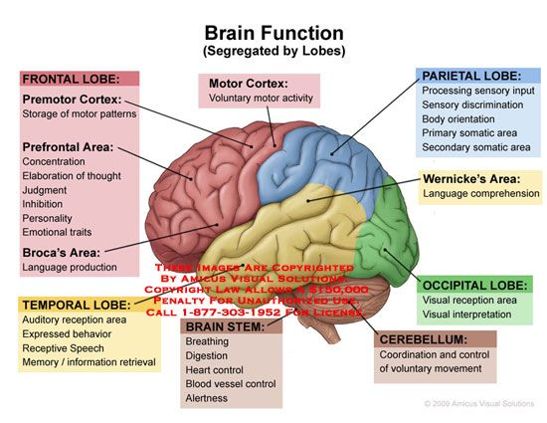
Functional areas of the cortex
Dominant/left brain:
-Right hemiparesis
-Right sensory problems
-”Looks toward the lesion”: left gaze preference
-Aphasia (comprehension/production)
Non-Dominant/right brain:
-Left hemiparesis
-left sensory problems
-“Looks toward the lesion”: right gaze preference
-left hemineglect (does not recognize own body part in space)
Notes:
Nurses need basic understanding of brain function (lobes); Vascular Circulation territories: Large vessel vs. small vessel, Anterior circulation vs. posterior circulation, Right side or left side symptoms
8

Slide 9
Brain Circulation
Anterior Circulation
Posterior Circulation
Motor
Sensory
Language
Neglect
Vision
Balance/Coordination
Eye Movements
Bulbar function
Consciousness
Notes:
Anterior circulation: primarily supplies frontal, parietal and temporal lobes: Posterior Circulation = occipital lobe, brainstem, cerebellum and thalamus (VA-> BA, supplies brainstem, cerebellum, thalamus)
Anterior circulation is captured better than posterior with regards to NIHSS

Slide 10
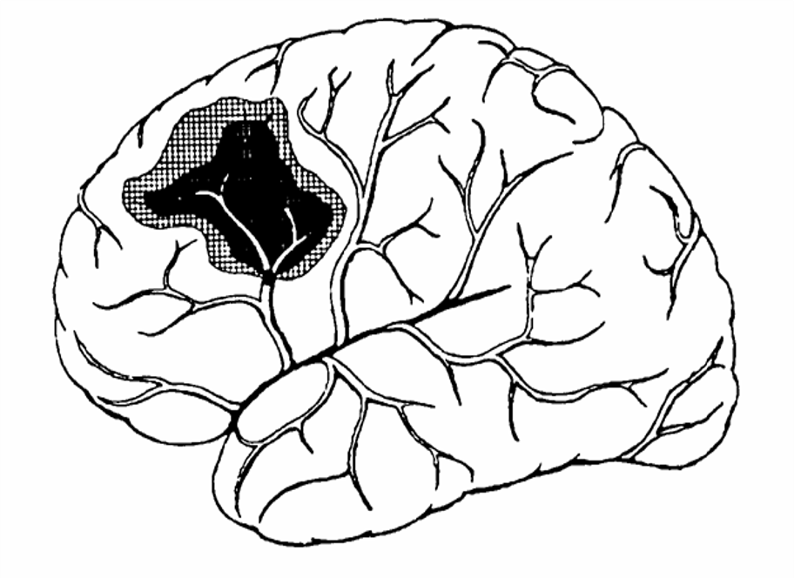
Progression of symptoms
Penumbra: at risk brain tissue
First thoughts:
Why?
  New infarct?
  Hemorrhage into the stroke?
  Unwitnessed seizure?
  Metabolic change?
  Loss of collateral flow?
Evaluation:
  Vital signs
  Imaging
Ischemic core: dead brain tissue/infarct
Thrombus/embolism
Notes:
Talking points:
Early intervention of acute stroke is to minimize damage to at risk tissue, and disability, worsened outcomes.
Nursing neurologic examination is important. Reporting significantly worse exams is important. Symptom progression/worsening tells us something is going on (could be normal evolution versus something new causing worsening)
Further evaluation helps us determine why the patient is worsening and is there something that can be done about it (ie BP, expansion of the stroke, swelling, bleeding (new vs expansion), seizure etc
10

Slide 11
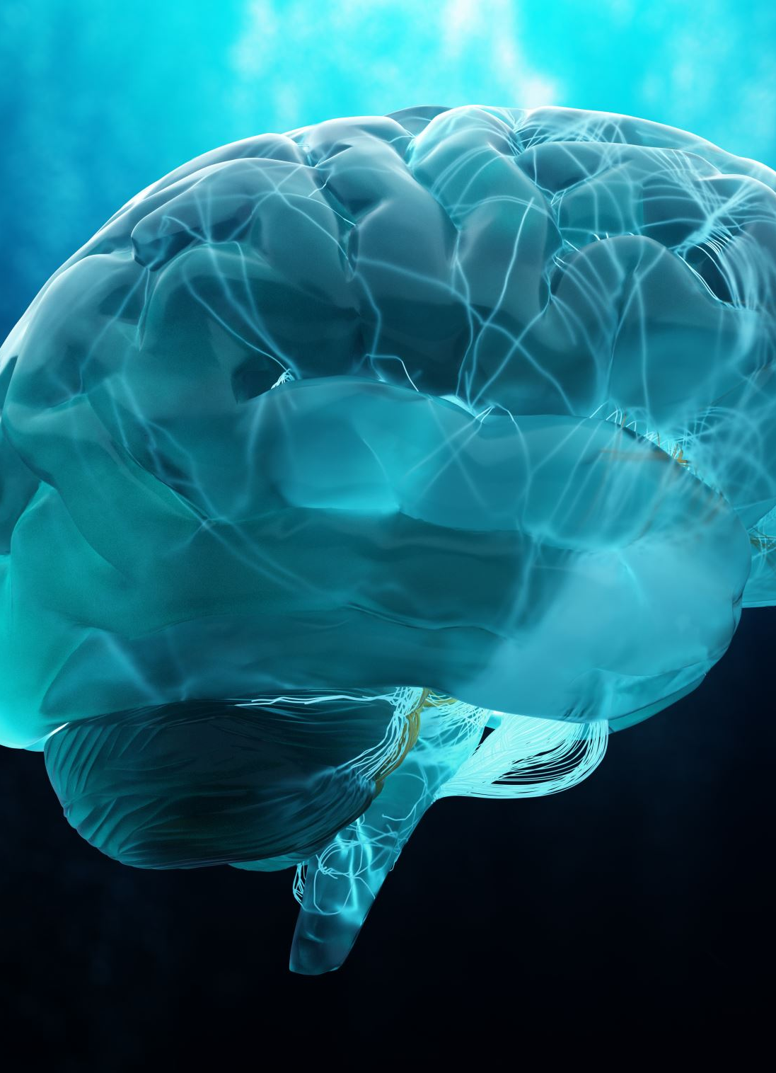
Progression of symptoms = stroke evolution or previously healthy brain is being damaged
“Friends and Neighbors”
  A stroke may initially involve only part of an arterial territory
  Neurologic findings = territory involved
  New neurologic findings = new part of brain being damaged
    Involvement of more of the arterial territory: new aphasia, new gaze deviation; OR
    Compression of a nearby structure due to brain swelling - Herniation
Notes:
11

Slide 12
Case Studies

Slide 13
51 yo male PMH cardiomyopathy, Ef 15%, admitted for flu (fevers, nausea, vomiting, diarrhea).
0630 Code stroke
-difficulty answering 2-part questions
-word finding difficulty
-aphasia
-LKW 0400
-NIHSS 4
0908 Code Stroke reactivated
-obtained CT Perfusion
-consideration of TNK in the extended window
Code stroke imaging
-Negative bleed
-no large evolving stroke
-no LVO
-mild stroke, non-disabling symptoms
-Suspect metabolic encephalopathy
0940
-Treated with IV TNK
additional collateral from wife who was at bedside (head at foot of bed, not himself, disoriented, couldn’t sit up straight, difficulty getting words out prompting initial code stroke).
Notes:
K.A.G (left MCA infarct: left inferolateral frontal, post central gyrus, semi-ovale, left insular cortex) reason follow-up exam done NP concerned patient was eligible for TNK in extended window at this point, NIHSS (aphasia is debilitating though NIHSS score is low).

Slide 14
LOC
alert
incorrect age, month
Facial Palsy
Mild right facial weakness
Motor
Strength 5/5 throughout
RUE pronator drift
Sensory
Best Language
decreased sensation to light touch RUE/RLE
Dysarthria
unable to describe scenario on NIHSS cards
impaired sentence repetition (non-sensical)
Extinction
mild slurred speech
unable to sense right side touch w/DSS
Unstable gait

Slide 15
To Score or Not to Score: What is the NIHSS?
5
9
12
Notes:
Audience question
What is the calculated NIHSS score? 9
(2-1b, 1 mild facial, 1 RUE drift, 2-sensory, 1-best language mild-mod; 1- dysarthria, 1 extinction/inattention)
repeat 2 hours later post TNK NIHSS 7; total 5 hours post TNK NIHSS 4 (1-minor facial weakness; 2-sensory; 1-mild-mod aphasia)…12/24 discharged NIHSS

Slide 16
48 y.o. female with PMHx of iron deficiency anemia, MDD, HTN, HLD, smoker? and vitiligo who presented
with altered mentation and agitation, after a MVA (backed into EV charging station).
ER arrival exam
-EMS/police escort
-oriented x1 (person), not time, place, events
-no other neuro deficits reported
-open liquor bottle in car
Imaging results
0622 results discussed with ED PA (+ hypodensity; L ICA occlusion w/ext L M1, + thrombus L cervical CCA
Diagnostics
-CT Head negative
-Blood alcohol (undetected)
-UDS (+) THC
Code stroke
0629 code stroke activated
0657 CT perfusion
LKW 730pm 7/28
7/29 underwent MT TiCi 2b
0140:Preparing for DC
-pt reports unable to stand/walk
-1H 18 m later CTA H/N ordered
-2.5 hrs later CTA completed
Bedside nurse reported throughout her shift pt had AMS, agitation, moving around a lot while cuffed to stretcher, and very hard to understand, but was following commands. (No documented neurologic assessment between 7/28 1922 and 7/29 1000am post MT
Notes:
A.B. Was noted to be disoriented to time, place, event; only oriented to self. Code stroke pre-intervention ?17; 1a-c 2, 2, 2; 2. 0, 3. 0 4. 0, 5a–b 2,2 6a-b 7. 0, 8. 0 9. 3 10. 0 11. 0
24h NIH 14 1, 2, 0,0,0,0,0, 3, 0, 3, 0, 0, 3, 2, 0; DC NIH 14; 0, 0, 1, 0, 0, 2, 0, 3, 0, 3, 0, 0, 3, 2, 0
No neuro assessment by nursing from arrival to 10am post MT; only GCS on arrival (14)

Slide 17
LOC
awake, alert
Best gaze
no gaze preference
+BTT
Sensory
(-) withdrawal to pain RUE
(+) weak withdrawal to pain RLE
Facial Palsy
Motor
right partial paralysis
dense right hemiparesis
Best Language
No command following
intermittent thumbs up, not always appropriately
Non-verbal
Notes:
Motor function: 0= holds; 1=drifts (AG, drifts doesn’t hit bed), 2=lifts (AG some effort, voluntary movement, but falls to bed before 10;5 secs), 3=cannot lift AG, but has some voluntary movement on bed plane/body; 4= no voluntary movement at all; aphasia discuss how to assess if pt non-verbal; intubated etc

Slide 18
To Score or Not to Score: What is the NIHSS?
14
17
19
Notes:
Audience question:
What is the calculated NIHSS score? 14:1a-c 0,0,1; 2. 0; 3. 0; 4. 2; 5a-b 0,3; 6a-b. 0,3; 7. 0; 8. 0; 9. 3; 10. 2; 11. 0

